Slide 1
Microservices

Slide 2
Microservices Goals & Practices
Strategic Goals
Architectural Principles
Design & Delivery Goals
Enable scalable business
More customers/transactions
Self-service for customers
Support entry into new markets
Flexible operational processes
New products and operational processes
Support innovation in existing markets
Flexible operational processes
New products and operational processes
Reduce Inertia
Make choices that favor rapid feedback and change, with reduced dependencies across teams
Eliminate accidental complexity
Aggressively retire and replace unnecessarily complicated processes, systems, and integrations so you can focus on essential complexity
Consistent interfaces and data flow
Eliminate duplication of data and create clear systems of record, with consistent integration interfaces
No Silver Bullets
Prescriptive solutions may deliver early value but often create inertia and accidental complexity
Small independent services
Simplified integration
Reduced impact of changes
Shorter planning & delivery cycles
Increased flexibility & control
Standard REST/HTTP based integration
Consolidated and cleansed data
Continuous deployment

Slide 3
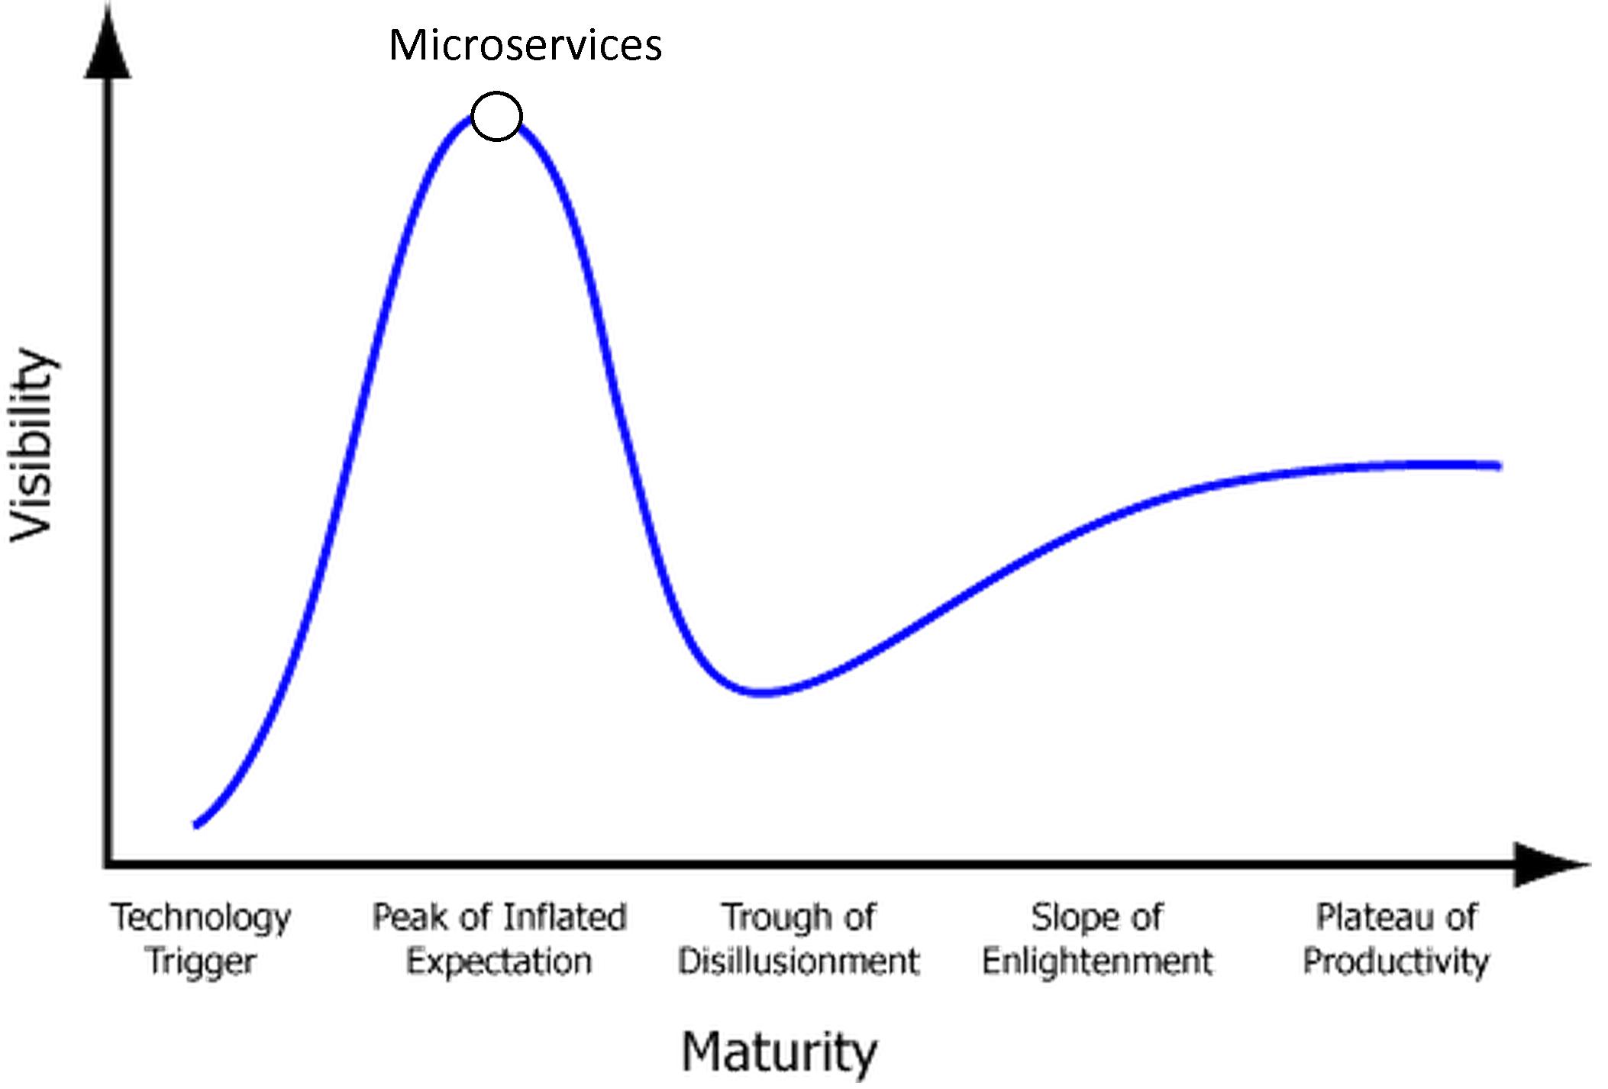
Microservices Use Cases
2015 Microservices “Hype Cycle”
Decomposing existing large “monolithic” application(s) or service(s) that are becoming difficult/expensive to maintain, into smaller, more maintainable, autonomous units
Adding flexibility to independently change or replace one part of the system without affecting all the consumers of that functionality
Designing components that must scale to very high levels
Reducing the impact of data latency by transforming from batch-oriented processes to event-driven processes
Delivering new functionality faster
Reducing cost, risk, and impact of change
When choosing to build microservices:
Be mindful of
Distributed system challenges
Operational challenges
Plan carefully for
Appropriate separation of concerns
System integration
Monitoring & alerting

Slide 4
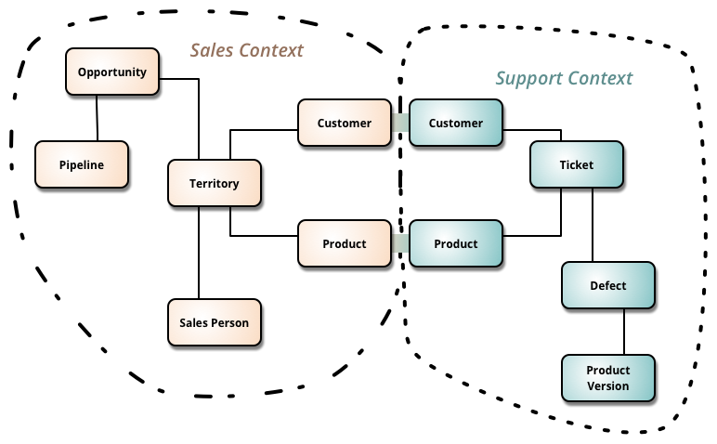
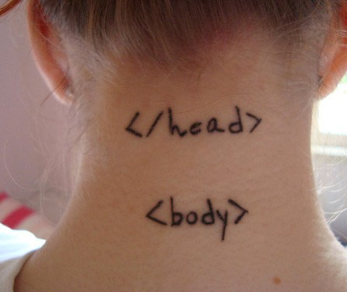
Definition: Microservice
“Loosely coupled service oriented architecture
with bounded contexts”
Adrian Cockcroft
“Applications that fit in your head”
James Lewis

Slide 5


Definition: Microservice
…the microservice architectural style is an approach to developing a single application as a suite of small services, each running in its own process and communicating with lightweight mechanisms, often an HTTP resource API.
http://martinfowler.com/articles/microservices.html
Loosely coupled service oriented architecture with bounded context.
http://www.slideshare.net/adriancockcroft/dockercon-state-of-the-art-in-microservices
8

Slide 6
Definition: Microservice
“a software architecture style in which complex applications are composed of small, independent processes communicating with each other using language-agnostic APIs. These services are
small, highly decoupled and focus on doing a small task, facilitating a modular approach to
system-building.” - Wikipedia
https://en.wikipedia.org/wiki/Microservices

Slide 7


Definition: SOA
A paradigm for organizing and utilizing distributed capabilities that may be under the control of different ownership domains. It provides a uniform means to offer, discover, interact with and use capabilities to produce desired effects consistent with measurable preconditions and expectations.
Service-Oriented Architecture (SOA) is an architectural style that supports service-orientation. Service-orientation is a way of thinking in terms of services and service-based development and the outcomes of services.
A service:
Is a logical representation of a repeatable business activity that has a specified outcome (e.g., check customer credit, provide weather data, consolidate drilling reports)
Is self-contained
May be composed of other services
Is a “black box” to consumers of the service
https://www.oasis-open.org/committees/tc_home.php?wg_abbrev=soa-rm
http://www.opengroup.org/subjectareas/soa
6

Slide 8
Microservices vs. SOA
Wikipedia: distinct from a Service-oriented architecture (SOA) in that the latter aims at integrating various (business)
applications whereas several microservices belong to one application only”
Martin Fowler: “This common manifestation of SOA has led
some microservice advocates to reject the SOA label entirely, although others consider microservices to be one form of SOA”
Oracle: “The picture that emerges is not of microservices as an alternative to SOA, but rather as a way to restore flexibility that may have been lost in SOAs that became too rigid and
monolithic.”
https://en.wikipedia.org/wiki/Microservices http://martinfowler.com/articles/microservices.html#MicroservicesAndSoa http://www.oracle.com/technetwork/issue-archive/2015/15-mar/o25architect-2458702.html

Slide 9
Microservices vs. SOA
Microservices:
Many very small components
Business logic lives inside of single service domain
Simple wire protocols(HTTP with XML/JSON)
API driven with SDKs/Clients
SOA:
Fewer more sophisticated components
Business logic can live across domains
Enterprise Service Bus like layers between services
Middleware

Slide 10

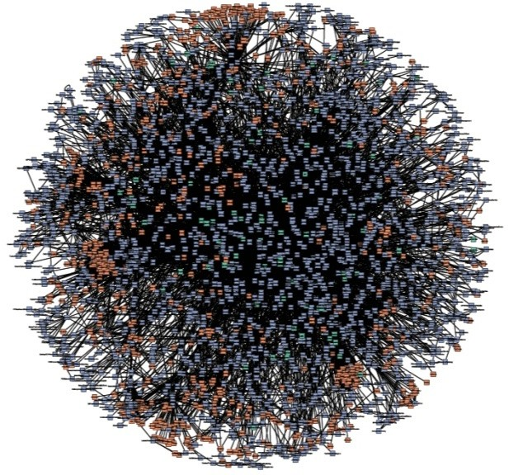
Single-purpose
Connect only through APIs
Connect over HTTPS
Largely “black
boxes” to each other
Microservices

Slide 11
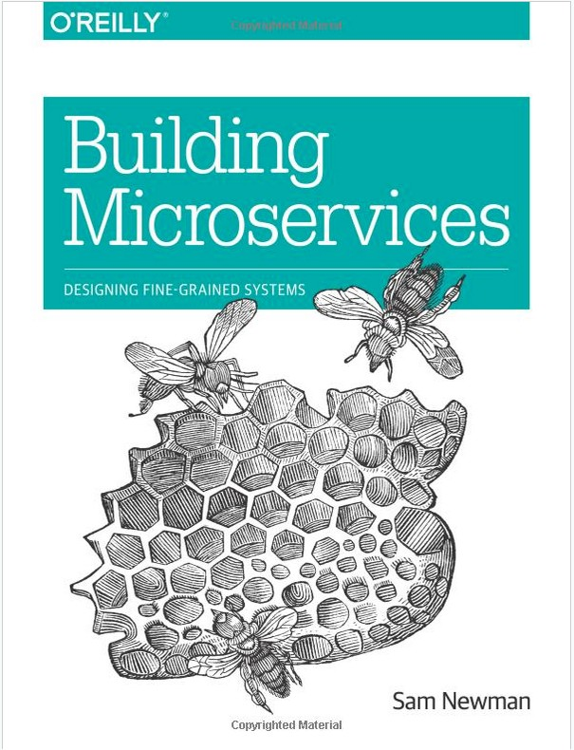
Microservices
Smart people are talking about it:
Sam Newman - book “Building
Microservices” O’Reilly Publishing
Adrian Cockcroft – numerous talks, presentations, blog posts
“Loosely coupled service oriented architecture with bounded contexts”
Martin Fowler – numerous blog posts
2 sessions at AWS Re:Invent 2014
~8 sessions at AWS Re:Invent 2015

Slide 12
Organizations are sharing tools
Netflix: Dozens of tools - https://netflix.github.io/
Airbnb: SmartStack - http://nerds.airbnb.com/ smartstack-service-discovery-cloud/
Twitter: Mesos - https://mesos.apache.org/
LinkedIn: Rest.li - https://github.com/linkedin/ rest.li

Slide 13


Early adopter: Warner Music
Warner Software Factory Platform
New applications and major updates
Before: 6 months, team of 10 developers
After: 6 weeks, same team
Speed/Agility: 400% faster on new platform
HR Hard Savings: $1.1M per application update delivered

Slide 14
Microservices have now gone mainstream
Gilt: “From Monolith Ruby App to Distributed Scala Micro- Services” NYC Tech Talks
Nike: “Nike’s Journey to Microservices” – AWS Re:Invent 2014
SoundCloud: ”Building Products at SoundCloud—Part III: Microservices in Scala and Finagle”
Capital One: “Lack Of Legacy Lets Capital One Build Nimble Infrastructure” – ThePlatform.net
Hailo: “A Journey into Microservices” – sudo.hailoapp.com

Slide 15
Microservices Challenges

Slide 16

Microservices Introduce New Architectural Constraints
Microservices represent a radical departure from traditional monolithic applications
Containers optimize for 12 Factor Linux applications
In both cases, the enterprise is forced to “think different.”

Slide 17
Simple vs. Easy
Simple
sim- plex
one fold/braid
vs complex
Easy
ease < aise < adjacens
lie near
vs hard

Slide 18
Monolithic Architecture
HTML
JavaScript
MVC
Service
Service
Data Access
Browser
Monolithic Application
Relational Database

Slide 19
Monolithic Architectures
Complex / Easy
Modularity Dependent Upon Language / Frameworks
Change Cycles Tightly Coupled / Obstacle to Frequent Deploys
Inefficient Scaling
Can Be Intimidating to New Developers
Obstacle to Scaling Development
Requires Long-Term Commitment to Technical Stack

Slide 20
Microservice Architecture
Relational DB
HTTP
HTTP
Key/Value Store
HTTP
HTTP
HTTP
…
AMQP
AMQP
HTTP
Graph DB

Slide 21
Microservice Architectures
Simple / Hard
Modularity Based on Component Services
Change Cycles Decoupled / Enable Frequent Deploys
Efficient Scaling
Individual Components Less Intimidating to New Developers
Enables Scaling of Development
Eliminates Long-Term Commitment to Technical Stack

Slide 22
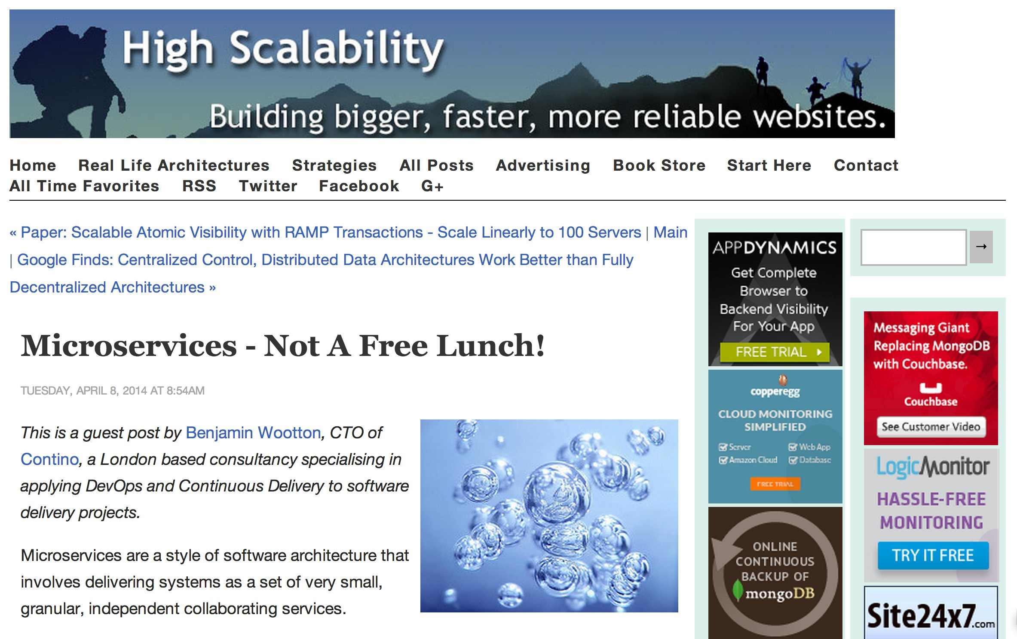
http://highscalability.com/blog/2014/4/8/microservices-not-a-free-lunch.html

Slide 23
Distributed System Complexity
Microservices imply distributed systems.
concerns:
latent/unreliable networks
fault tolerance
load variability

Slide 24
The network is reliable. Latency is zero.
Bandwidth is infinite. The network is secure.
Topology doesn't change. There is one administrator. Transport cost is zero.
The network is homogeneous.
Eight Fallacies of Distributed Computing
https://blogs.oracle.com/jag/resource/Fallacies.html

Slide 25
Paying for your lunch…
Significant Operations Overhead
Substantial DevOps Skills Required
Implicit Interfaces
Duplication of Effort
Distributed System Complexity
Asynchronicity is Difficult!
Testability Challenges

Slide 26
Establishing a pattern for services and clients
It’s important that the organization isn’t reinventing the wheel on every new service:
How are clients going to communicate?
What cross service authorization requirements are there?
How do services prevent abuse?
How do you quickly build clients against a service?
How do services handle discovery of others services and resources?

Slide 27

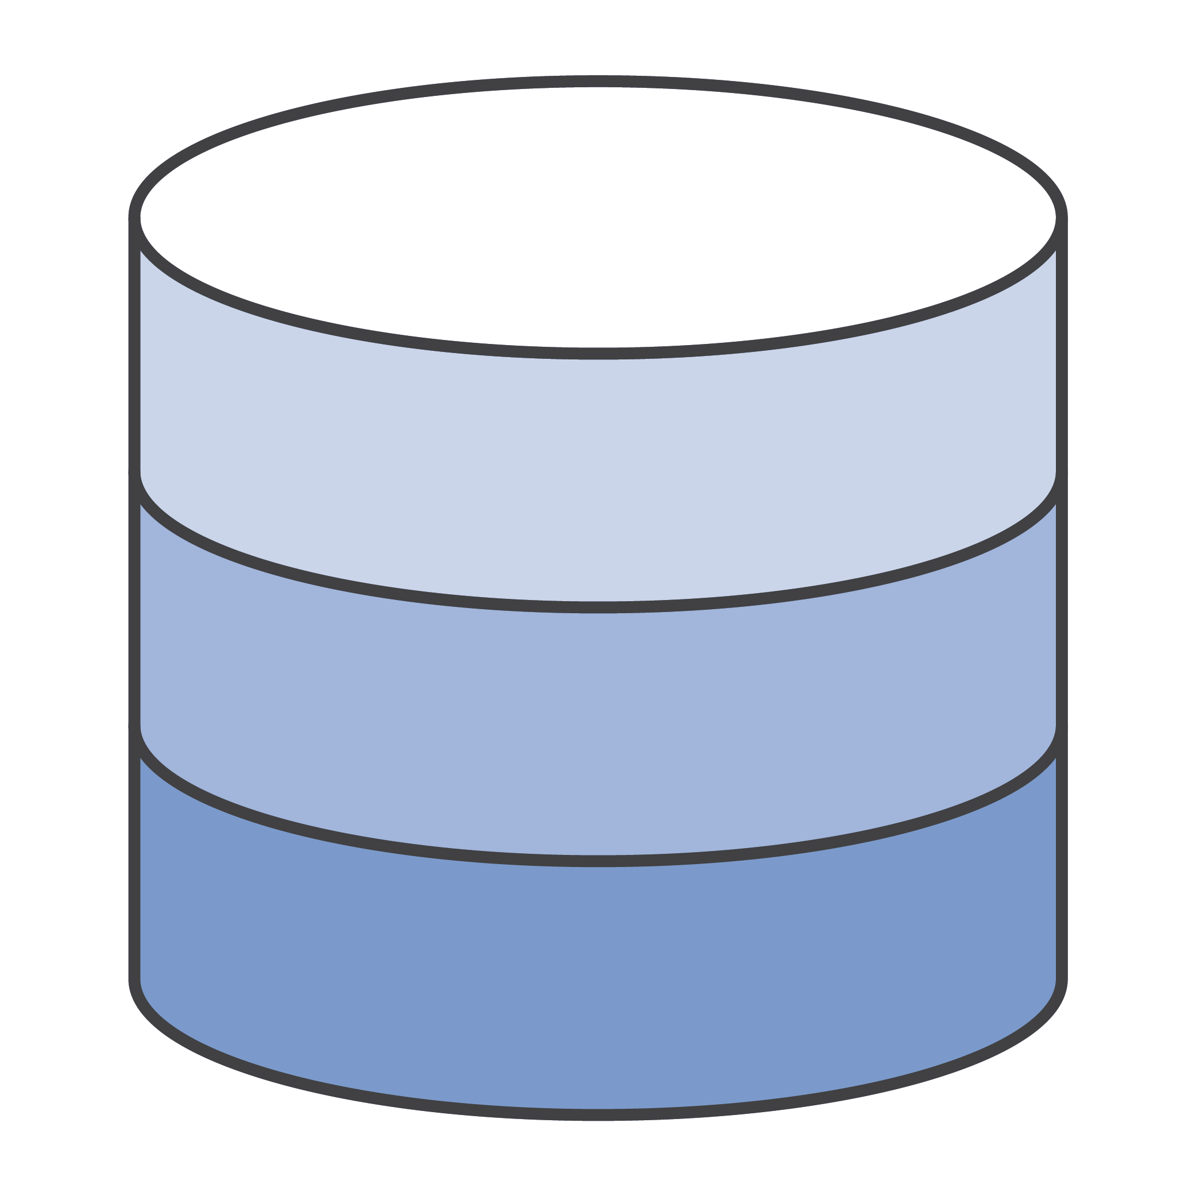


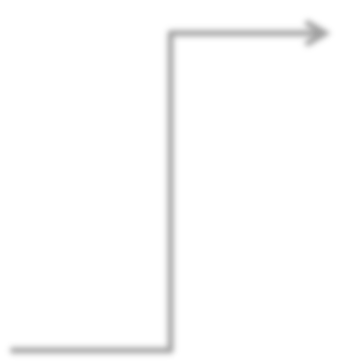
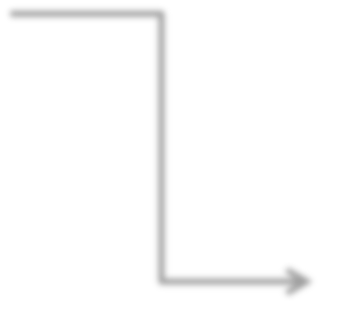











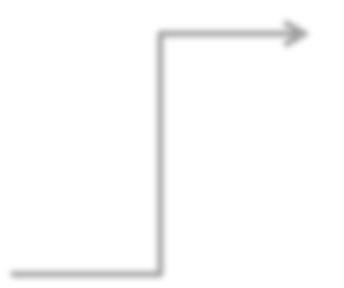





Use an API Gateway!
API Gateway Cache
AWS Lambda functions
Mobile Apps
API
Gateway
Websites
Internet
Amazon CloudFront
Endpoints on Amazon EC2
Services
Amazon CloudWatch Monitoring
Any other publicly accessible endpoint

Slide 28
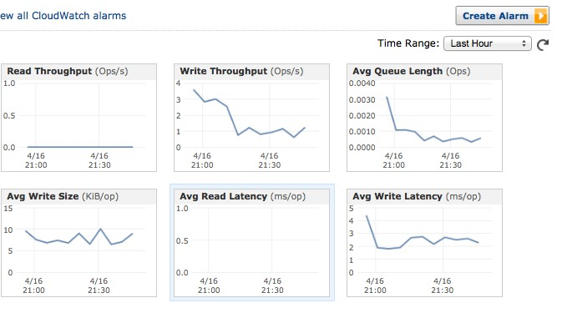
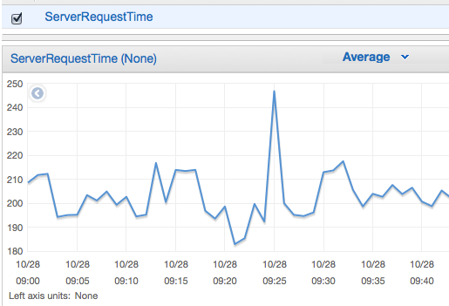




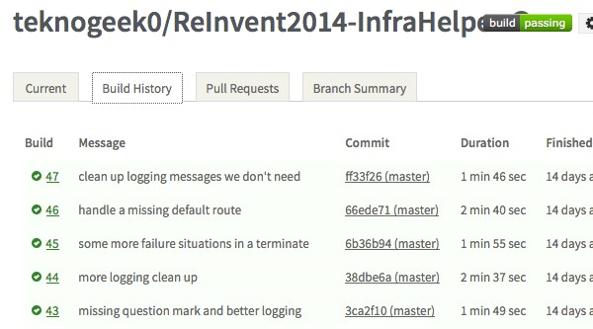
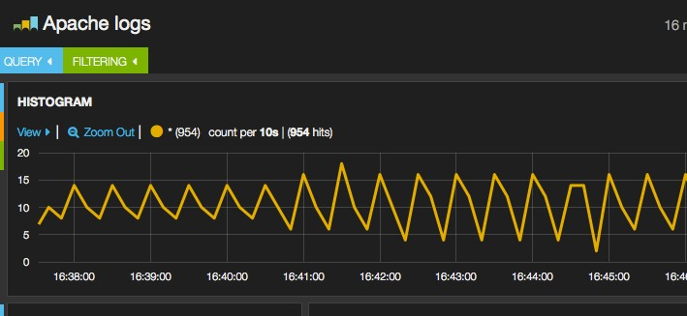




SERVICE METRICS
HOST METRICS
LOG ANALYSIS
BUILD METRICS

Slide 29


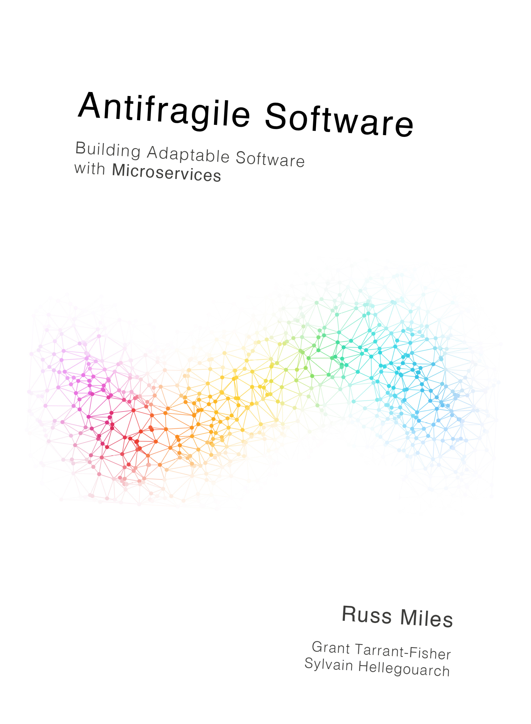
www.leanpub.com/antifragilesoftware

Slide 30


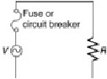



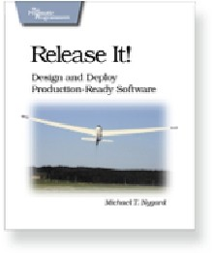
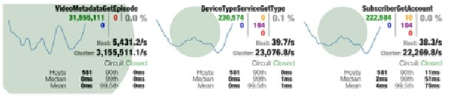
FAULT TOLERANCE PATTERNS
[failure threshold reached]
CIRCUIT BREAKER
Trip breaker
CLOSED
OPEN
[call fails]
Trip Breaker
[call succeeds]
HALF OPEN
on timeout
Attempt Reset
Reset
Netﬂix/ Hystrix
28

Slide 31
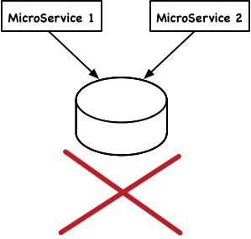
No Shared DBs
Each microservice should have it’s own databases and Data must not be shared via a database
This prevents tight coupling between services via database schema
However, strong consistency ( if needed) across data sources is hard in this model.
You either have to do distributed transactions (DON’T) or use compensations.

Slide 32
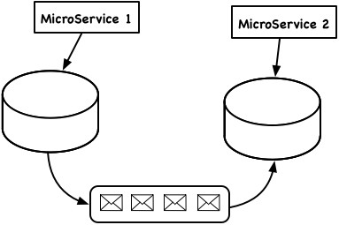
When data (DB) is shared?
If updates happens only in one microservice (e.g. loan approval process check the balance), you can use a asynchronous messaging (message queue).
If updates happen in both services, perhaps, you need to consider merging the two services. ( for example see https://www.tigerteam.dk/2014/micro-services-its-not-only- the-size-that-matters-its-also-how-you-use-them-part-2/ )
If not see Next slide: Transaction

Slide 33
Transactions
o When possible, avoid transactions crossing microservice boundaries o Depend lesser guarantees ( e.g. use timeouts, update via
persistent messaging): see
Starbucks Does Not Use Two-Phase Commit and https://news.ycombinator.com/item?id=7995130
o Use compensation o Read
Life Beyond Distributed Transactions: An Apostate’s Opinion o There are some use cases where you must do distributed
transactions ( that cross microservice boundaries) o Those MUST use transactions (e.g.
http://jbossts.blogspot.com/2015/04/microservices-and-
transactions-update.html)

Slide 34
APIs are forward compatible
The commonly understood “contract” between microservices is that their APIs are stable and forward compatible.
Forward compatibility is a design characteristic that allows a system to gracefully accept input intended for a later version of itself
Idea is that microservice can switch to new versions, without all it’s dependencies having to switch.
Idea is loose coupling letting each party evolve individually o Good idea to do explicit API versioning
Might be costly in same cases, also support for older versions have to be dropped at some point

Slide 35
How to build Microservices Feature Teams

Slide 36

Conway’s Law
“organizations which design systems ...
are constrained to produce designs which are copies of the communication structures of these organizations”
- Melvin Conway, 1968
12/08/15

Slide 37

Conway‘s Law
Architecture copies
communication structures of the organization

Slide 38

DISTRIBUTION / FRAGMENTATION

Slide 39


DISTRIBUTED TEAMS

Slide 40

EXECUTION CHALLENGES
Agile
Stakeholders
Multi-Partners
Policies
Constraints
Way of working
Money!
Trust

Slide 41
OTHER CHALLENGES
Co-Existence
Scope
Data Migration
Team Distribution & Integration
Defect Management

Slide 42
NON FUNCTIONAL REQUIREMENTS
Auditability
Performance
Compliance
Security
Accessibility

Slide 43





CODE QUALITY
Customization team(s)
Core product team(s)
Integration & conﬁguration team(s)
NFR
Team(s)
Systems team(s)

Slide 44
Challenges for Scaling Agile
> Dependencies cause delays
> Too much communication about functionalities...
> ...releasing software,
> ...and technologies

Slide 45

Challenges for Scaling Agile
> Dependencies cause delays
> Too much communication about functionalities...
> ...releasing software,
> ...and technologies

Slide 46

Challenges for Scaling Agile
> Dependencies cause delays
> Too much communication about functionalities...
> ...releasing software,
> ...and technologies

Slide 47
Conway‘s Law: Impact
Architecture and
communication structures in the organization
are the same thing.

Slide 48
Conway’s Law as a Limit
> Organization drives architecture
> Teams of experts
> i.e. UI, logic & database team
> Three technical artifacts

Slide 49
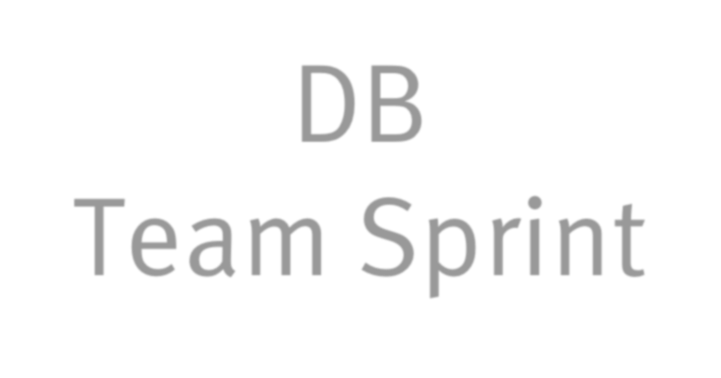

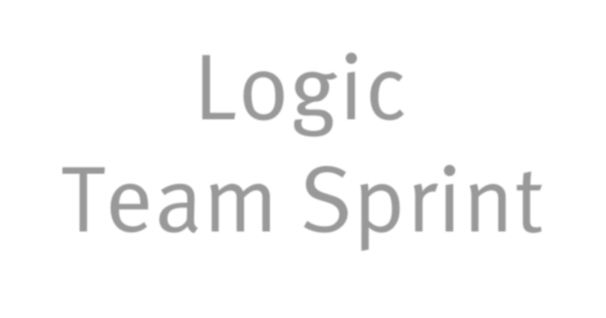


3 sprints
DB
Team Sprint
Logic
Team Sprint
GUI
Team Sprint
time

Slide 50
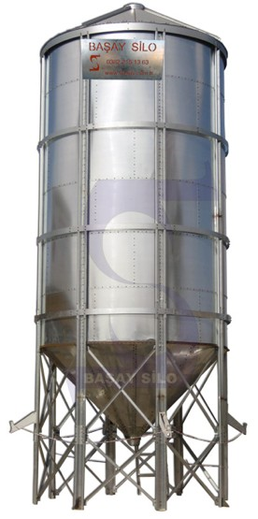





Lack of cohesion, shared understanding and joint accountability
Hand-oﬀ delays
Hand-oﬀ delays
Slow feedback
Slow feedback
Dev
QA
Ops
Front-end
Database

Slide 51
How To Think About Architecture
> Process has an impact on architecture
> Software architecture & organization are the same

Slide 52
Rather than creating teams to work on projects, let’s find ways to give work to cross- functional teams.
Principle:

Slide 53
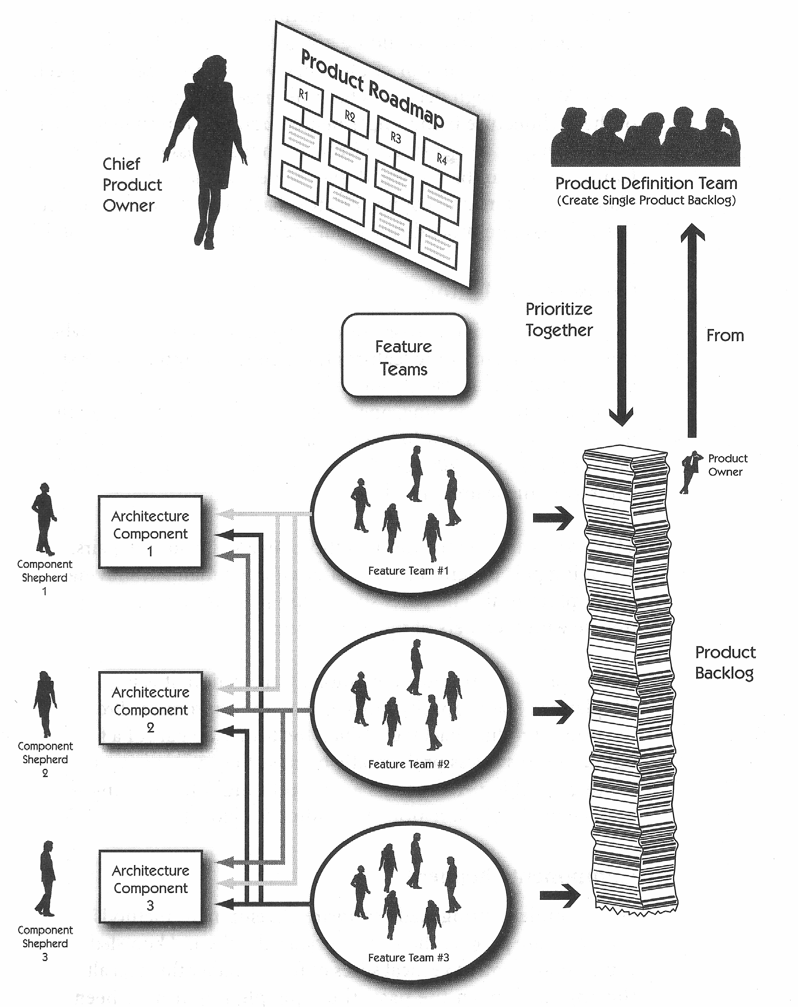
Feature Team
“Feature Team” structure
Uses common Product Backlog Integration is done in parallel
Requires high levels of communication across teams to resolve integration issues
Forces Product Owners to be more coordinated
Sprints should be synchronized
Cross team fertilization is a requirement to successfully deliver in parallel

Slide 54

Two-pizza teams
Full ownership
Full accountability
Aligned incentives
“DevOps”

Slide 55
How do Two Pizza Teams work?
We call them “Service teams”
Own the “primitives” they build:
–Product planning (roadmap)
–Development work
–Operational/Client support work
“You build it, you run it”
Part of a larger concentrated org (Amazon.com, AWS, Prime, etc)

Slide 56




The Two Pizza Team
Who Does QA?

Slide 57


The Two Pizza Team
Who Does On Call?

Slide 58


Not Exist
What does Ops Do?

Slide 59
What about Ops/QA/Etc?
Everyone exists on a “service team” focused on their primitive(s):
SDE’s focused on developing
PM’s focused on product direction
TPM’s help drive development
SE’s focused on infra/tooling
SDET’s focused on test excellence throughout the organization
Some folks are shared across the org, some on individual teams

Slide 60
Isn’t that a lot of freedom?
It is! Teams are empowered and also held to high standards:
Thorough onboarding/training
Patterns/practices defined at scale and with 20+ years of organizational knowledge
Regular technical and business metric reviews
Regular sharing of new tools, services, technologies, etc, by internal subject matter experts

Slide 61


Challenges new Feature Teams face
> More self-organization
> Decide about technologies, releases etc.
> Need to be more cross- functional
> E.g. ops skills become more important

Slide 62

The keys to your own Two Pizza teams & Microservices
Culture
– Ownership & Accountability go hand in hand
– Larger teams typically move slower than smaller teams
– Insist on standards of excellence, but be flexible on the how
Practices
– Continuous Integration & Delivery
– Simplify operational tasks
Tools
Internal “Service teams” should own, support,
train, drive excellence of these tools
CI & CD tools
Infrastructure management
Metrics/Monitoring/Logging
Communication and Collaboration
36

Slide 63
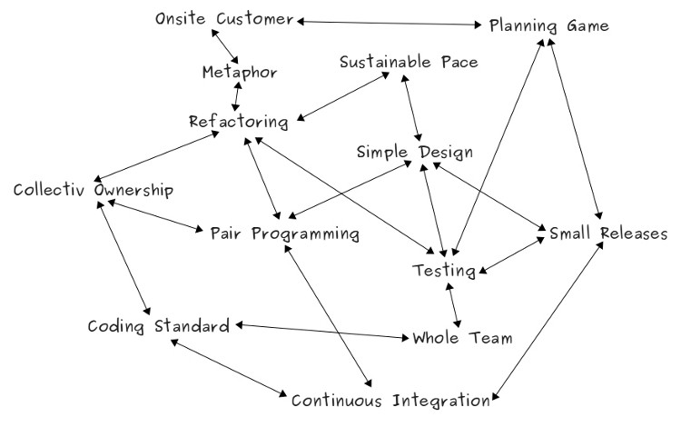
How XP Practices Support Each Other
http://www.kusmin.eu/wiki/index.php/How_XP_Practices_Support_Each_Other

Slide 64
RECAP
Microservices patterns are changing how we are building APIs and our applications in general
Team structure plays an incredible role in building, running, scaling Microservices
Focusing on flexible tooling that provides standards can help an organization focus on what matters
Enable the smart people you hire to do great things by giving them both ownership and accountability on those things
success
41

Slide 65
Continuous Delivery & DevOps

Slide 66
App Developers Can Be More Successful When They Are Supported By Agile Infrastructure

Slide 67
Continuous Integration (CI)
”… is a software development practice where members of a team integrate their work frequently, usually each person integrates at least daily - leading to multiple integrations per day. Each integration is veriﬁed by an automated build (including test) to detect integration errors as quickly as possible…."
- Martin Fowler, ThoughtWorks Chief Scientist
➢➢ http://www.thoughtworks.com/continuous-integration

Slide 68
Continuous Delivery (CD)
… is the natural extension of Continuous Integration: an approach in which teams ensure that every change to the system is releasable, and that we can release any version at the push of a button. Continuous Delivery aims to make releases boring, so
we can deliver frequently and get fast feedback on what users care about.
- Martin Fowler, ThoughtWorks Chief Scientist
➢➢ http://www.thoughtworks.com/continuous-delivery

Slide 69
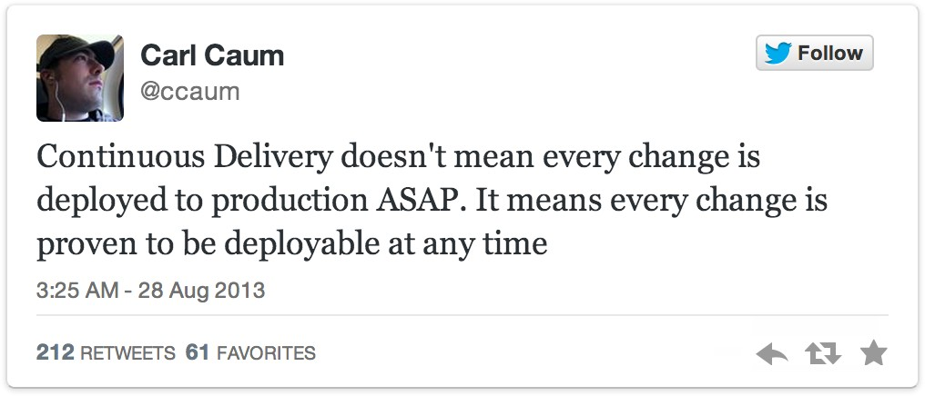
Continuous Delivery != Continuous Deployment
twitter.com/ccaum/statuses/372620989257232384

Slide 70
The Difference:
Who Presses The Button For A Production Deployment?

Slide 71
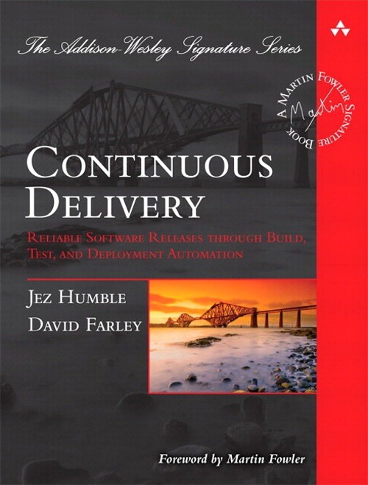
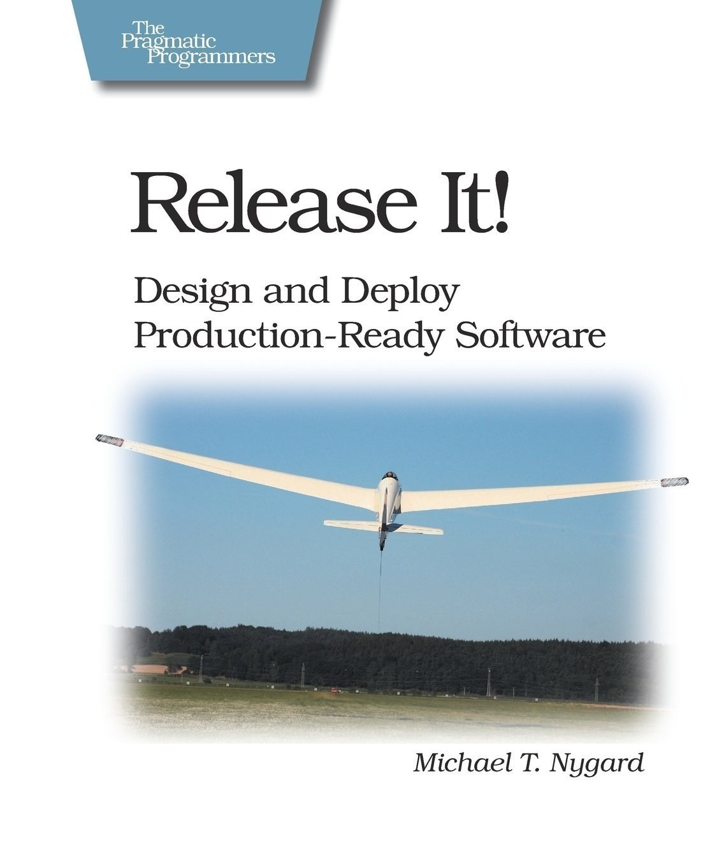
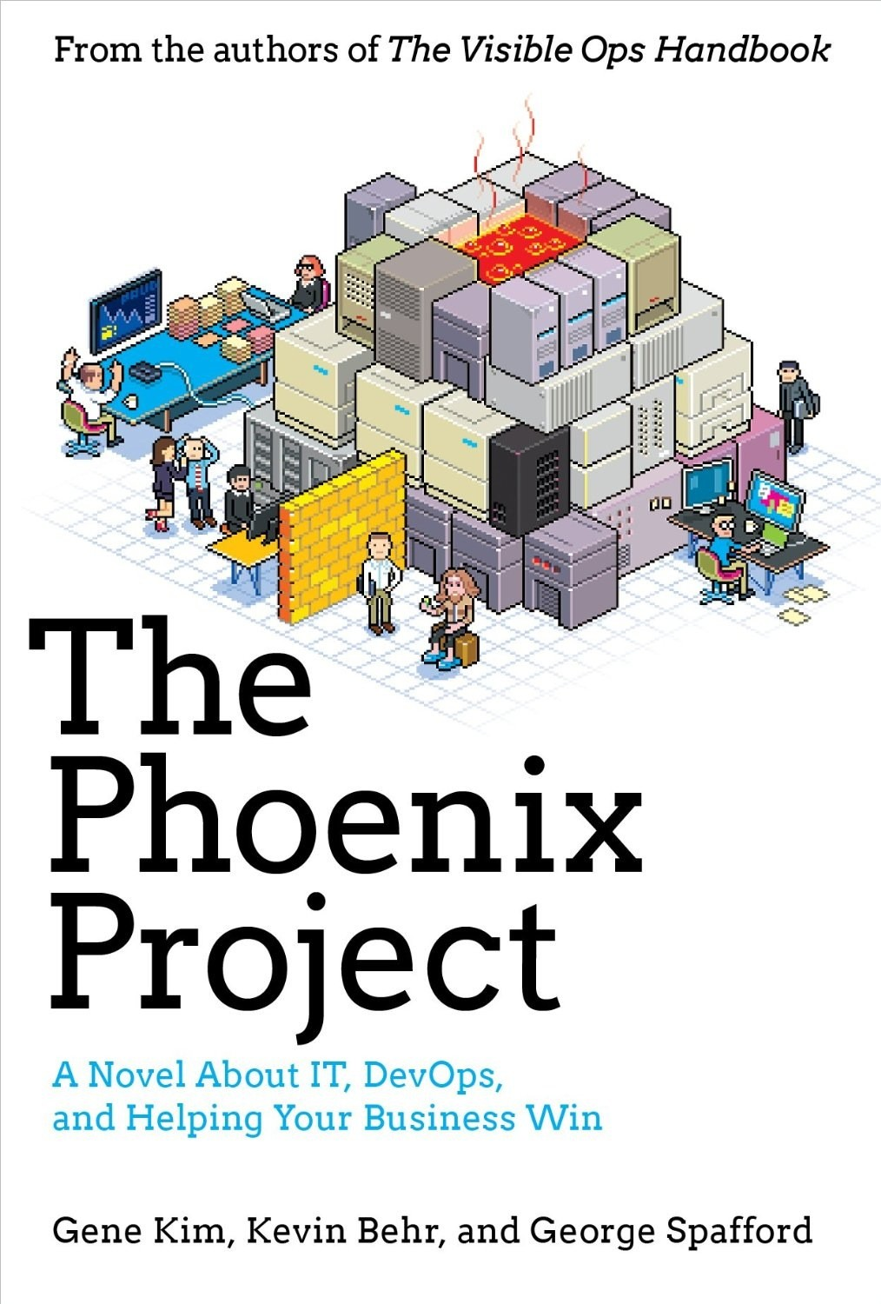
Continuous Delivery

Slide 72


Pipelines
Continuous delivery
From check-in to production
Automated actions and transitions
>90% of teams

Slide 73



Monolith development lifecycle
build
test
release
developers
app
delivery pipeline

Slide 74



Microservice development lifecycle
build
test
release
build
test
release
build
test
release
build
test
release
build
test
release
build
test
delivery pipelines
release
developers
services

Slide 75
Missing tools
???
developers
services
delivery pipeline

Slide 76







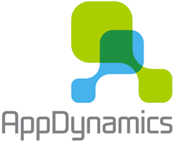
Tool chain
Continuous Integration
Source Control
Servers
Monitor
New
code
Deploy
Feedback

Slide 77
Tool chain
Continuous Integration
Source Control
Servers
Monitor
Microservices
New
code
Deploy
Containers
Feedback

Slide 78
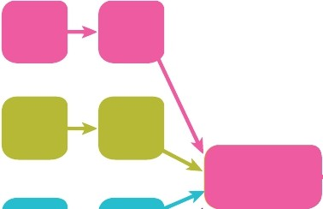


CENTRALISED PIPELINE
Build Test Integration Test
Acceptance Test Production

Slide 79
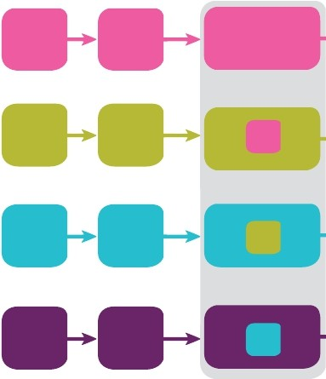





DECENTRALISED PIPELINE
Build Test Consumer Test
Acceptance Test Production

Slide 80


Enter the modern container
One environment development, testing, staging and production
Build once, run anywhere public cloud, private cloud, bare-metal server.
Over 40% of developers deploying to the cloud are using containers*
*Source: Cloud Development Survey 2015, Volume II, Evans Data

Slide 81
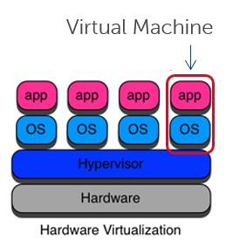
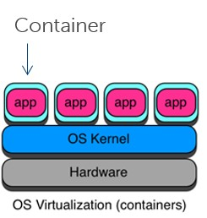
Containers vs VMs
Majority
Own OS/multiple varieties
More secure/Mature
Launch in seconds/minutes
Run for months
Shared OS/single type
Runs on Bleeding edge
Launch in microseconds
Run for minutes

Slide 82














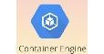


The landscape
(open source predominates)
Container Orchestration
Container Engines
Mini OSs
Clouds with Docker support

Slide 83

Deployment service
No downtime deployments
Health checking
Versioned artifacts and rollbacks

Slide 84

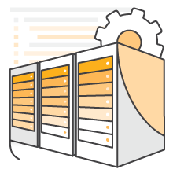
Apollo and Pipelines as AWS Services:
CodePipeline
launched July 2015
CodeDeploy
launched Nov 2014

Slide 85



DevOps: What it’s all about
Reducing friction, increasing velocity
Shorten
$
Dev
Ops
Feedback
“Slow” is the new “Down”

Slide 86
DevOps: What’s it all about
Tenets
Requirements
Benefits
Culture
Innovate faster
More responsive to business needs (customer)
Better quality
Iteration
New Mindset
New Skills
New Tools
“Fail” fast
Automation
Measurement
“Cloud” infrastructure/Open Source/Microservices

Slide 87



Adoption and the DevOps continuum
We believe that by 2016, DevOps will evolve from a niche strategy Employed by large cloud providers to a mainstream strategy employed By 25% of the largest 2000 global enterprises – Gartner[1]
Sources: [1]Tech Go-to-Market: How to win with DevOps buyers, May 15, 2015; Gartner

Slide 88
Strategies For Success

Slide 89
Strategies For Success
Do Implement Continuous Integration

Slide 90
Strategies For Success
Do Not Create Environment Specific Packages

Slide 91
Strategies For Success
Do Externalize Environment Specific Configuration

Slide 92
Strategies For Success
Do Automate Everything

Slide 93
Strategies For Success
Do Not Assume Existing Processes Are Right (Engage In Continuous Improvement)

Slide 94
Strategies For Success
Do Not Use A Different Process For Different Environments

Slide 95
Strategies For Success
Do Recreate App Environments Frequently (Also Known As: Servers Are Not Puppies)

Slide 96
Strategies For Success
Do Ensure Database Changes Are Automated

Slide 97
Strategies For Success
Do Automate All Testing Where Test Failures Would Prevent A Production Release From Occurring

Slide 98
Strategies For Success
Do Try To Use Tools That Support The Process (But Don’t Get Stuck In Tool Selection Paralysis)

Slide 99
Defining Microservices Boundaries

Slide 100
Conway’s Law
Any organization that designs a system (defined broadly) will produce a design whose structure is a copy of the organization's communication structure.
Melvyn Conway, 1967
http://martinfowler.com/articles/microservices.html#OrganizedAroundBusinessCapabilities.

Slide 101


Slide 102

Complexity
The critical complexity of most software projects is in understanding the domain itself.
Eric Evans

Slide 103

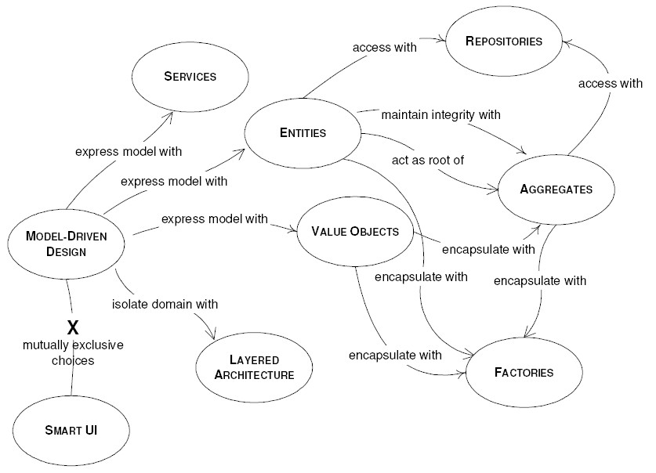
Domain Driven Design

Slide 104
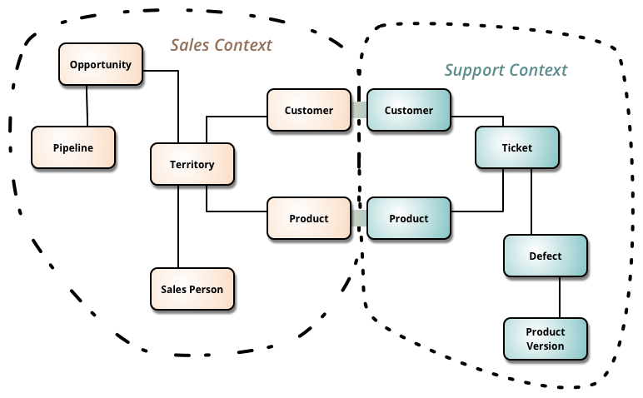
Bounded Contexts
DDD deals with large models by dividing them into different Bounded Contexts and being explicit about their interrelationships.
http://martinfowler.com/bliki/BoundedContext.html

Slide 105
Build microservices around domain services within bounded contexts.

Slide 106
Organize Around Business Capabilities
UI Specialists
Middleware
Specialists
DBAs
Business Capability
Business Capability
Business Capability
Siloed Functional Teams
Cross- functional Teams
HTML
JavaScript
MVC
Siloed Application Architectures
Microservice Architectures
Service
Service
Data Access
http://martinfowler.com/articles/microservices.html#OrganizedAroundBusinessCapabilities

Slide 107
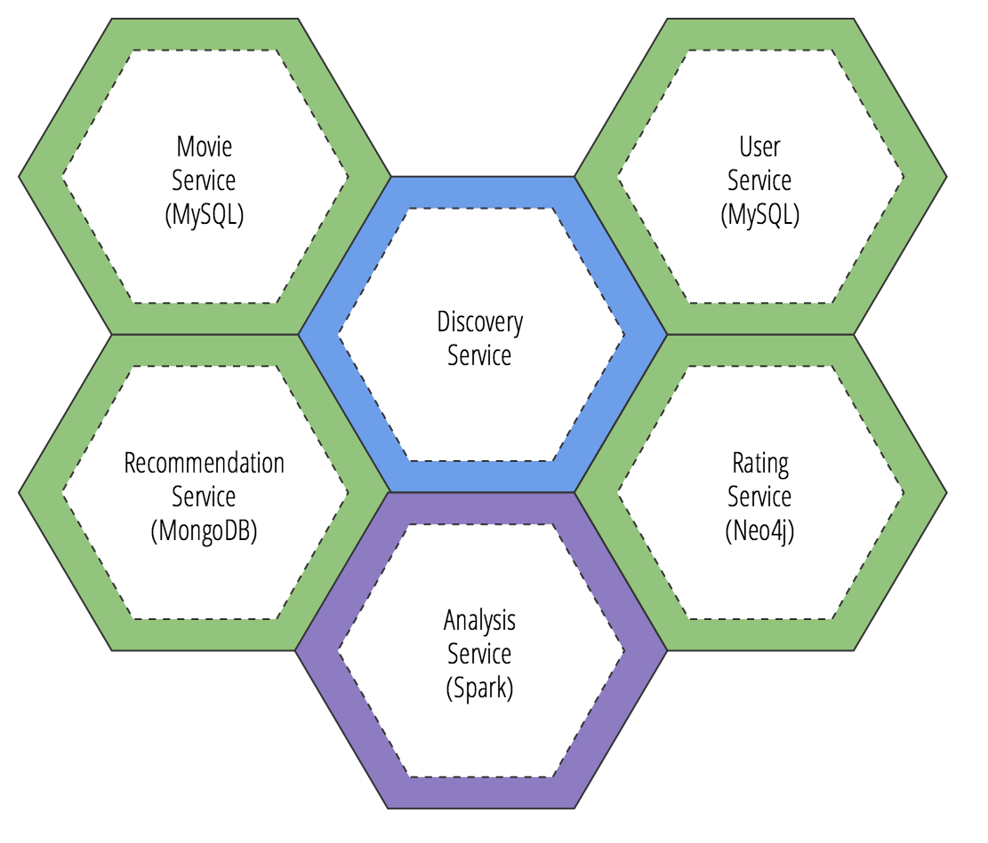
http://www.kennybastani.com/2015/08/polyglot-persistence-spring-cloud-docker.html

Slide 108
Partitioning Strategies
By Noun (e.g. product info service)
By Verb (e.g. shipping service)
Single Responsibility Principle (http://programmer.97things.oreilly.com/wiki/index.php/ The_Single_Responsibility_Principle)

Slide 109



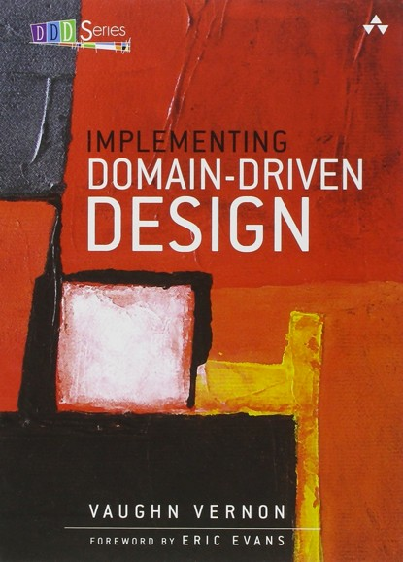
Don’t Share Domain Models Across Domains
Don’t try to have One Model to Rule Them All
Breaks encapsulation
Introduces coupling
Know your DDD
Entities
Value Objects
Aggregates and Roots

Slide 110
How Many Microservices?
•
Size - what really matters is quality not quantity
•
Services should be decoupled conceptually so that they can evolve independently
Services should be decoupled technically so that they can be managed independently
•
•
What do I do, practically?
•
Co-locate services, but avoid implicit dependancies though shared common objects
Separate services but avoid sharing (domain) libraries
•

Slide 111
Provide as many APIs and Services as you need, but no more.

Slide 112
How to Define Microservices Boundaries
•
Don’t stress about how many APIs or Services
Do stress about designing an appropriate domain models for your services
Don’t separate your services based on technical boundaries
Do separate your services based on self-contained functions
•
•
•

Slide 113
How to Define Microservices Boundaries
Design your API contracts first Communicate them well
Use tools to document them, e.g
apidocjs (http://apidocjs.com/)
swagger (http://swagger.io)
spring-restdocs (https://github.com/spring-projects/spring-restdocs)
•
•
•
•
Be mindful of the impact of changing an API

Slide 114
How to Define Microservices Boundaries
If you don’t specify your contract, you end up with an implicit one anyway
Use the power of resources (HTTP and REST)
•
•
•
Location
Uniform interface
Status codes Representations
•
•
•

Slide 115




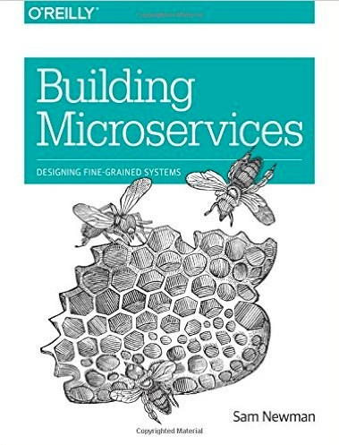
Reading
Patterns of Enterprise Application Architecture
Martin Fowler
Domain Driven Design
Tackling Complexity in the Heart of Software
Eric Evans
Building Microservices Designing Fine-Grained Systems Sam Newman

Slide 116

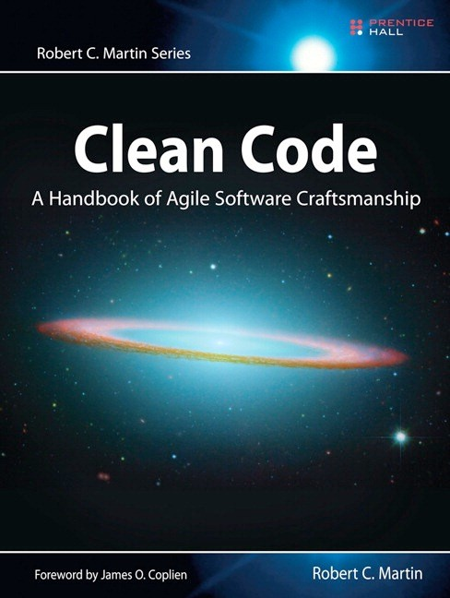

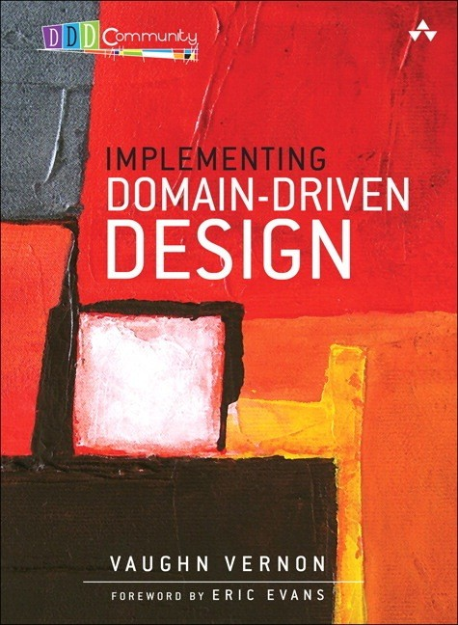
Reading
Clean Code
A Handbook of Agile Software Craftsmanship
Robert C. Martin
Implementing Domain Driven Design
Vaughn Vern

Slide 117
Refactoring to Microservices

Slide 118
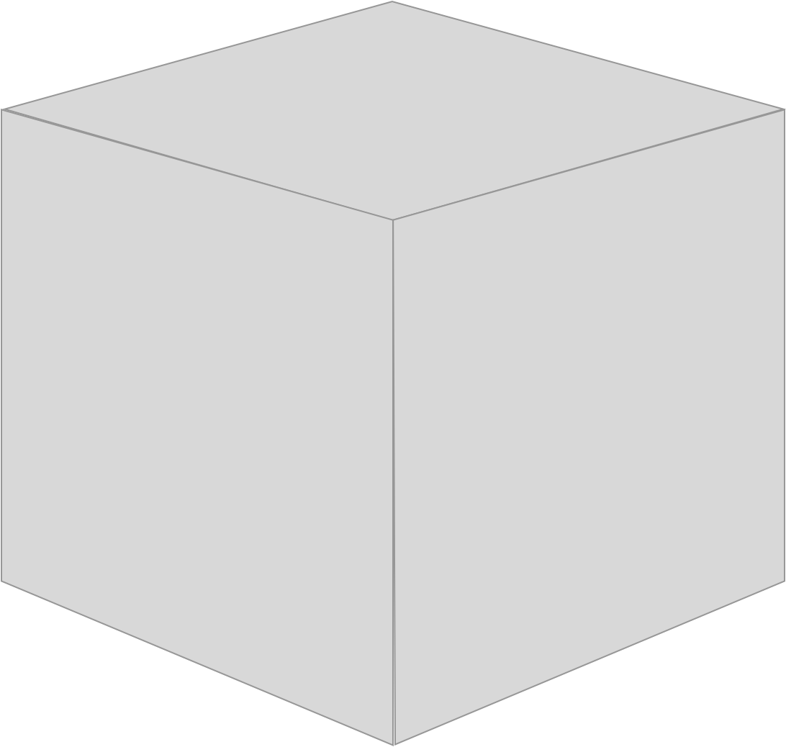
Deployment monolith
Graphics by Roman Stranghöhner, innoQ http://scs-architecture.org

Slide 119
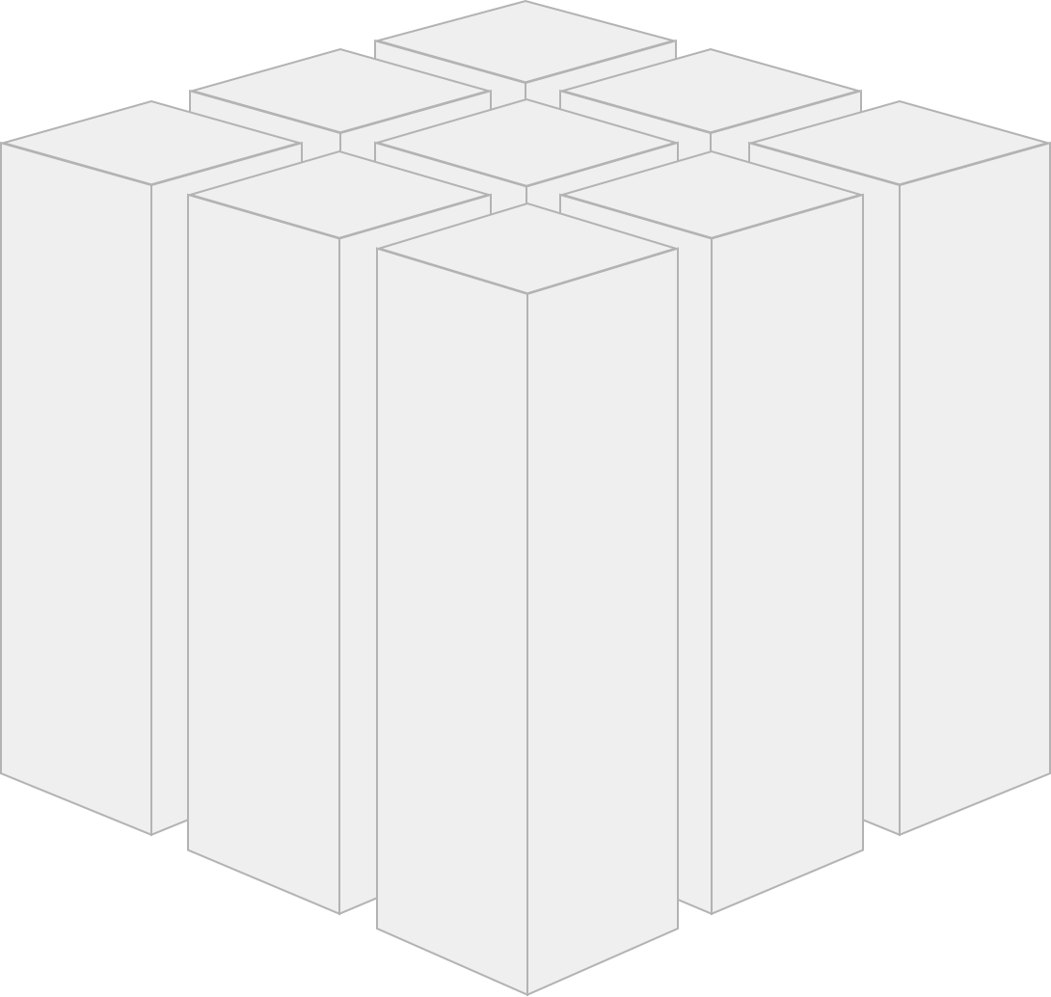
Cut Deployment monolith along domains …

Slide 120
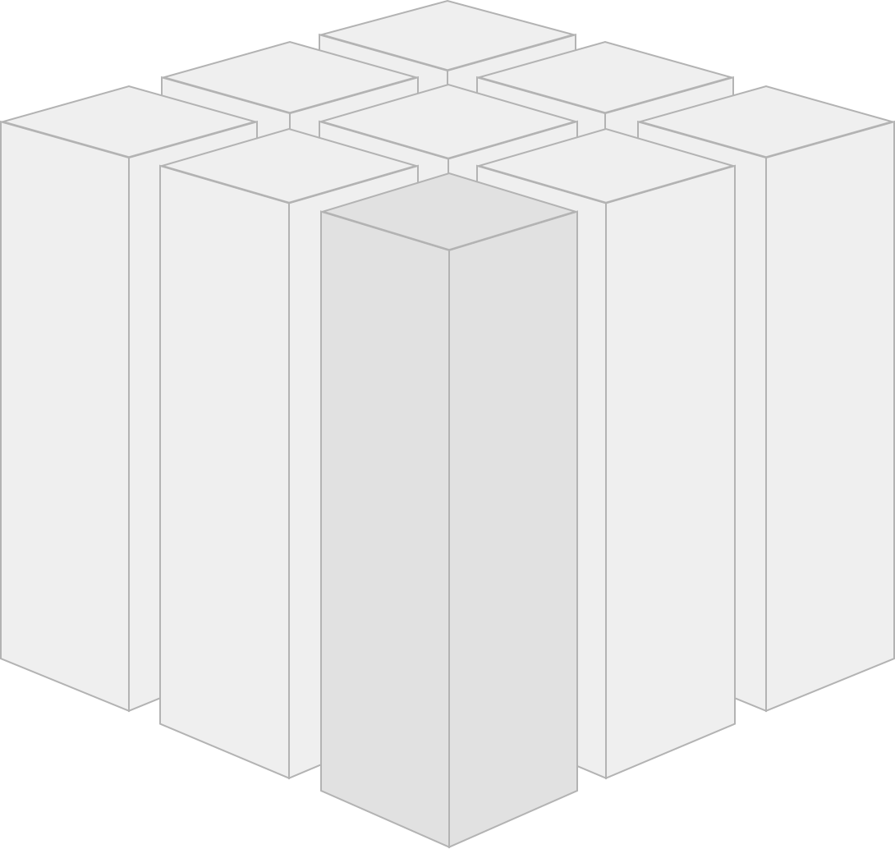
… wrap domain in
separate web application …

Slide 121

Self contained System (SCS) – individually deployable

Slide 122
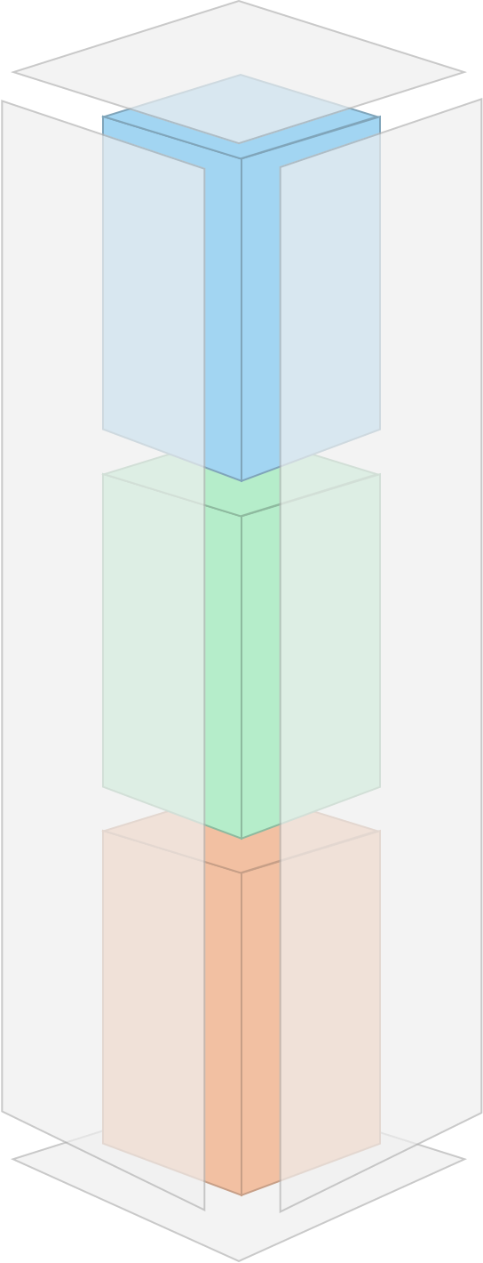
SCS =
user interface+ business logic+ data storage

Slide 123


Self-contained systems enable the development of a domain by a single team
– no coordination
Order Team =
UI+Logic+Database

Slide 124
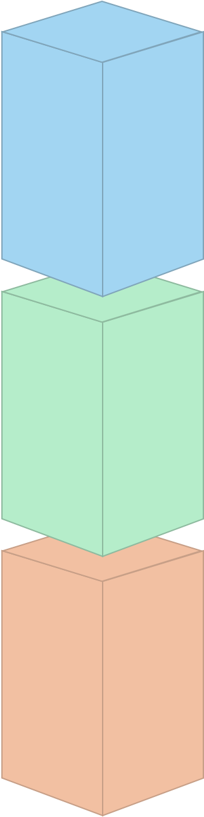
Technical decisions can be made independently from other systems (programming language, frameworks, tooling, platform)

Slide 125
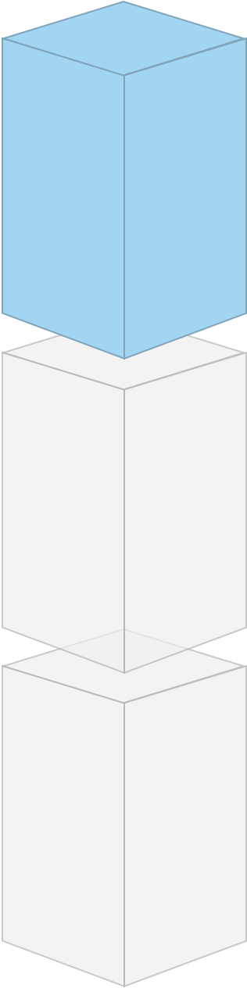
Web user interface

Slide 126
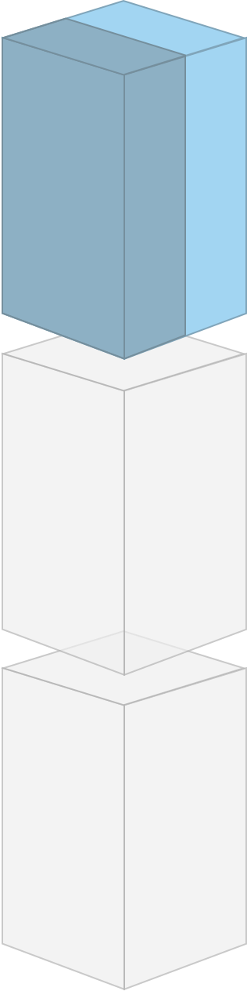
optional API e.g. for mobile

Slide 127

Self-contained Systems
should be integrated in the web interface

Slide 128



System 1 System 2
Hyperlinks to navigate between systems.

Slide 129




System 1 System 2
Dynamic inclusion of content served by another application

Slide 130

Logic only shared over a well defined interface.

Slide 131

Business logic can consist of
microservices

Slide 132

Avoid synchronous remote calls

Slide 133

Remote API calls should be
asynchronous

Slide 134

Every SCS brings its own data storage with its own (potentially redundant) data

Slide 135
Self-Contained Services enable greater Agility
> Self Contained Services
> less dependencies
> less delays
> less communication about functionalities
> Technological freedom
> less communication about technologies
> Independent releases
> no need to coordinate releases

Slide 136
Testing Microservices

Slide 137







IDEAL TEST AUTOMATION PYRAMID
Manual / Exploratory
UI
Business- facing Tests
Web Service
Impact
View
Time
JavaScript
Technology- facing Tests
Integration
Cost
Unit

Slide 138


ICE-CREAM CONE ANTI PATTERN
Manual / Exploratory
UI
Web Service View
JavaScript Integration Unit

Slide 139


DUAL TEST PYRAMID ANTI-PATTERN
Web Service
View
JavaScript Integration Unit
Manual / Exploratory
UI
Web Service
Developers Test Pyramid
QA Team Test Pyramid

Slide 140

CUP-CAKE ANTI-PATTERN

Slide 141

TO GET EARLY FEEDBACK – YOU NEED TO...
Categorize Tests
Identify tests
for speciﬁc environments
DevOps
Smart Automation
Testing cannot work in isolation
Test Consolidation
Identify correct & appropriate environments
Single Dashboard
Maintenance
Processes, Practices & Tools
Common repository
Test Prioritization

Slide 142

Microservices Testing Strategies
http://martinfowler.com/articles/microservice-testing/

Slide 143


Invest in your build pipeline testing
Serenity BDD
Wiremock/Saboteur
Jenkins Performance plugin

Slide 144

Tools also exist for debugging in production…
Do it in production(?)
Netflix
Hailo
Gilt
This is an advanced pattern!
Automation is essential!

Slide 145
DEBUGGING MICROSERVICES

Slide 146
Debugging microservices
Microservices turn a monolithic system into a distributed one
While resilient to certain classes of force majeure failures, distributed systems remain vulnerable to software defects
Distributed systems are infamously nasty to debug — not least because they often must be debugged in production

Slide 147
Microservice failure modes
Implicit
Gives the wrong answer Returns the wrong result
Leaks resources Stops doing work Performs pathologically
Non-fatal
Emits an error message Returns an error code
Segmentation violation Bus Error
Panic
Type Error
Uncaught Exception
Fatal
Assertion failure Process explicitly aborts
Exits with an error code
Explicit

Slide 148
Cascading microservice failure modes
Implicit
Gives the wrong answer Returns the wrong result
Leaks resources Stops doing work Performs pathologically
Non-fatal
Emits an error message Returns an error code
Segmentation violation Bus Error
Panic Type Error
Uncaught Exception
Fatal
Assertion failure Process explicitly aborts
Exits with an error code
Explicit

Slide 149
Debugging fatal failure
When software fails fatally, we know that its state has become inconsistent
By saving in-memory state to stable storage, the software can be debugged postmortem
To debug, you start with the invalid state and reason backwards to discover a transition from a valid state to an invalid one
This technique is so old, that the terms for this saved state dates back to the dawn of the computing age: a core dump
Not as low-level as the name implies. Modern high-level languages (e.g., node.js and Go) allow postmortem debugging.

Slide 150
Debugging fatal failure: microservices
Postmortem analysis lends itself very well to microservices:
There is no run-time overhead; overhead (such as it is) is only at the time of death
The microservice/container can be safely (automatically!) restarted; the core dump can be analyzed asynchronously
Tooling need not be in container, can be made arbitrarily rich

Slide 151
Debugging non-fatal failure
Fatal failure always represents a software defect at some level — and the inconsistent state is static
Non-fatal failure can be more challenging: the state is valid and
dynamic — it’s difficult to separate symptom from cause
Non-fatal failure must still be understood empirically
Debugging in vivo requires that data be extracted from the system
— either of its own volition (e.g., via logs) or by coercion (e.g., via instrumentation)

Slide 152
Debugging explicit, non-fatal failure
When failure is explicit (e.g., an error or warning message), it provides a very important data point
If failure is non-reproducible or otherwise transient, analysis of explicit software activity becomes essential
Action in one container will often need to be associated with failures in another
Especially for distributed systems, this becomes log analysis, and is an essential forensic tool for understanding explicit failure
Essential observation: a time line of events!

Slide 153
Debugging implicit, non-fatal failure
Problems that are both implicit and non-fatal represent the most time-consuming, most difficult problems to debug because the system must be understood against its will
Wherever possible make software explicit about failure!
Where errors are programmatic (and not operational), they should always induce fatal failure!
Microservices break at the boundaries: two services each think that they are operating correctly, but together they’re broken
Data must be coerced from the system via instrumentation

Slide 154
Instrumenting production systems
Traditionally, software instrumentation was hard-coded and static (necessitating software restart or — worse — recompile)
Dynamic system instrumentation was historically limited to system call table (strace/truss) or packet capture (tcpdump/snoop)
Effective for some problems, but a poor fit for ad hoc analysis
In 2003, Sun developed DTrace, a facility for arbitrary, dynamic instrumentation of production systems that has since been ported to Mac OS X, FreeBSD, NetBSD and (to a degree) Linux
DTrace has inspired dynamic instrumentation in other systems

Slide 155
Instrumenting Docker containers
In Docker, instrumentation is a challenge as containers may not include the tooling necessary to understand the system
Docker host-based techniques for instrumentation may be tempting, but they should be considered an anti-pattern
DTrace has a privilege model that allows it to be safely (and usefully) used from within a container

Slide 156
Debugging microservices in production
Debugging methodically requires us to shift our thinking — and learn how to carefully observe the systems we build
Different types of failures necessitate different techniques:
Fatal failure is best debugged via postmortem analysis — which is particular appropriate in an all-container world
Non-fatal failure necessitates log analysis and dynamic instrumentation
The ability to debug problems in production is essential to successfully deploy and scale microservices!

Slide 157
THE API ECONOMY

Slide 158
APIs are new business channels to engage with partners and customers
=
The API Economy is the global sum of digital transactions between multiple parties

Slide 159

What Kinds of APIs are in the New Enterprise
Source: Forrester, Establish your API design, June 2013

Slide 160
API Management

Slide 161
API management: noun man·age·ment\
ma-nij-mənt
a set of technologies and processes for creating, managing, securing, analyzing and scaling the APIs that power the apps and experiences that drive the digital world.
APIs: The foundation of digital business
BEING A DIGITAL BUSINESS MEANS BEING AN API-RUN BUSINESS
Customer and developer expectations are driving enterprise IT to employ new approaches for serving the needs of a diverse mix of users and experiences.
That’s where APIs come into play. They’re the foundation upon which digital business is built, enabling app developers to create apps and experiences that serve the needs of customers, regardless of channel or device.
With the explosion of apps and digital experiences, companies need better solutions to manage their APIs and API-driven businesses.

Slide 162
The API management solutions market will quadruple by 2020 as business goes digital.
Forrester 2015
Anatomy of an API management solution
AT ITS MOST BASIC, API MANAGEMENT MUST ATTRACT DEVELOPERS, MEDIATE TRAFFIC, AND MANAGE API DEPLOYMENT
A developer portal to attract and engage app developers, enabling them to discover, explore, purchase (or profit from), and test APIs, and register to access and use them
An API gateway to secure and mediate the traffic between clients and backends, and between a company’s APIs and the developers, customers, partners, and employees who use them
API lifecycle management to manage the process of designing, developing, publishing, deploying, and versioning APIs

Slide 163
Anatomy of an API management solution
SOPHISTICATED API MANAGEMENT FEATURES TURBO-CHARGE A DIGITAL BUSINESS
Secure
Backend as a Service (BaaS) capabilities to enable modern app features including social graphs, user management, data storage, push notifications, and performance monitoring
Analyze
Manage
An analytics engine that provides insights for business owners, operational administrators, and app developers, enabling them to manage all aspects of APIs and API programs
Scale
Create
API management
Create, manage, secure, analyze, and scale APIs and digital business.
API monetization to enable packaging, pricing, and publishing of APIs so partners and developers can purchase access or share revenue

Slide 164

API lifecycle management
CREATE, MANAGE, SECURE, ANALYZE, AND SCALE APIS
BUILD
Design & Develop
RUN
Secure & Deploy
API providers manage the processes for designing, developing, publishing, deploying, versioning, monitoring availability, and measuring performance.
Dev
API consumers (developers) discover new APIs, understand versioning and API updates, register for access to APIs, test and register apps built against the APIs, and communicate and collaborate with other developers and the API provider
Publish
Monetize
Analyze
USE
Publish, Analyze & Monetize

Slide 165






API management enables API developers, who expose assets via APIs, to unlock the value of business assets by creating APIs from existing data and services.
It enables API providers to see from the perspective
of app developers (the API consumers)
and to design and build APIs that are easy to use, following best practices.
Design and build APIs that developers love
THE DEVELOPER IS THE LYNCHPIN OF THE DIGITAL VALUE CHAIN AND THE API STRATEGY
USER
DEVELOPER
API TEAM
APP
API
BACKEND
1010100101001001001 1010100101001001001000010101010100101001010101000101 1010100101001001001000010101010100101001010101000101001010101

Slide 166

Publish APIs with the developer in mind
APIS ARE ONLY AS SUCCESSFUL AS THE DEVELOPERS WHO BUILD ON THEM
There are over 18.2M developers worldwide and over 50% of them are developing APIs.
Evans Data 2013
Developer productivity is critical. A developer portal enables companies to provide everything that internal, partner, and third-party developers need to be effective and productive building on the APIs.
The best developer portals provide a complete, self-service experience, by enabling developers to:
•
•
•
•
•
register apps
select the APIs and the service levels they need get secure access
monitor their API usage
monetize and participate in revenue sharing with the API provider

Slide 167


API Console & Smartdocs
Docs Manager
Authentication
Dev Manager
Community
Key Manager, OAuth
Developer
Dev Dash
Developer Portal
Forum, Blog
API Team
Dev Onboarding
API Dashboard
A developer portal provides everything developers need to be effective and productive building on APIs

Slide 168
API traffic management
CACHE QUOTA RATE LIMIT
SPIKE ARREST
API traffic management
MONITOR AND MODIFY THE BEHAVIOR OF APIS WITH CACHING, QUOTAS, RATE LIMITS, AND SPIKE ARREST
Caching improves API and app performance by storing data from backend resources for quick retrieval
Quotas and rate limits control the number of connections apps can make to the backend via the API
Spike arrest capabilities protect against traffic spikes and denial-of- service attacks

Slide 169

API security
SECURITY IS KEY AT ALL POINTS OF ENGAGEMENT ALONG THE DIGITAL VALUE CHAIN
1B
Records
In 2014, breaches of digital systems resulted in 1B records being lost to hackers
Gemalto Breach Level Index, 2014
Users
OpenID Connect
Apps
API keys,
app authentication
Developers
role-based access control
APIs
traffic control, quotas, DDoS
API Team
LDAP, role-based access control
Back-end
TLS
IP access control
Malicious users can access your systems through the same channels as legitimate users.
It’s critical for API management solutions to provide security that’s easily configurable and enabled at all points of engagement—from the APIs to the backend services and from the API to the apps.

Slide 170

API analytics
GET A 360-DEGREE VIEW OF API TRAFFIC, APP PERFORMANCE, AND OTHER BUSINESS AND OPERATIONAL METRICS
App Developer
How’s our
app doing?
Business Owner
How’s our
business doing?
Analytics
COLLECT
API management solutions provide the visualization tools, dashboards, and reports to measure a broad spectrum of data that flows across APIs.
ACT
ANALYZE
VISUALIZE
Beyond simple charts and graphs, both the ops and business teams can gain deep visibility—in real time—into the performance of the API program.
API Team
How’s our
API doing?
Ops
How’s our
system doing?
Apps

Slide 171
User Management
Data Storage
Social Integration
Geo-Location Push Notifications Analytics
BaaS enables developers to develop and extend apps with modern features
Backend as a Service (BaaS)
DATA STORAGE, SYNCHRONIZATION, AND MODERN FEATURES FOR APPS
BaaS or mBaaS (mobile BaaS) is a strategic addition to an API management solution.
Most modern apps require functionality including data storage and synchronization, messaging, geolocation, user management, push notifications, and social graph functionality.
All of these services are missing from existing backend systems, but are provided by BaaS via customized software development kits (SDKs) and APIs.

Slide 172
Monetization capabilities
Create and publish packages Price creatively
Limits, notifications Billing documents Detailed reporting Developer workflows
API monetization
MONETIZE YOUR APIS. SHARE REVENUE WITH YOUR DEVELOPERS.
API management solutions aren’t only a competitive advantage for enterprises, but also a potential source of revenue and a tool to build your developer ecosystem.
API monetization includes:
Rate plans to pay developers through revenue sharing, or charge them for the use of your APIs
Reporting and billing facilities
Limits to control and monitor API usage and performance

Slide 173

Scaling for success
Support massive scale across geographies
8,000
Plan for growth in API traffic as your business grows
Plan for spikes in API traffic as campaigns take off
Be highly available and reliable at scale
Scalability
LAUNCH LIKE A STARTUP, SCALE LIKE AN ENTERPRISE
Traffic bursts are a reality across industries.
Enterprises must be confident that their capacity can scale with dynamic traffic fluctuations.
An API management solution supports high-performance requirements, with architectures and distributed database technologies to perform
at scale.

Slide 174


Extensibility
THE POWER OF PLATFORM
A sophisticated API management solution is open to extension or complements from third parties.
It’s a platform that enables a business to easily extend its capabilities by supporting commonly used and popular languages including Java, Python, and JavaScript. It also supports open-source and customer- modifiable extensions.

Slide 175
API management:
THE GATEWAY TO THE DIGITAL ECONOMY
Secure
APIs have become the foundational technology for building
digital businesses.
Analyze
Manage
A digital business is one that delivers a connected digital experience to its customers through apps, data, and devices. Behind every app through any channel, on any device is an API.
A sophisticated API management solution enables businesses to create, manage, analyze, secure, and scale APIs.
Scale
Create

Slide 176
API Monetization & Chargeback

Slide 177





Popular APIs & categories

Slide 178



Content providers/ Digital properties
callout here
Data via APIs as a revenue stream

Slide 179


Digital services
callout here
Services via APIs as a revenue stream

Slide 180


Revenue sharing /commission models
Third party developers &/ aﬃliates get a % of the order value

Slide 181


Payment processing API

Slide 182
You pay Developer
Developer pays you
Revenue-sharing models
Fee-based models
Freemium models
Fixed
Transaction
Duration
Flexible
Quantity
Transaction Volume
Hybrid
(flat fee plus fixed or flexible)
Hybrid
Custom Attribute
Revenue / Volume Bands
One-time
Subscription
Advance / Arrears
Pro-rated / Full amount

Slide 183
What makes successful API programs?
Category
Clear value proposition
Little to no friction to try &/get started
Engaged partners/developer community

Slide 184



Extending the value of your digital strategy
Monetization for real business results
User
App
Developer
API
API Team
Backend

Slide 185






Monetization Use Cases: generating internal and external value
Internal Chargebacks
Internal Developer teamZZZ
B2C or B2B Scenario
API Team
App User / Customer
B2E Scenario
$
App Developers / Partner
App User Department
API Team

Slide 186






Ecosystem: API Providers, Partners & Developers
API Provider
Developer Portal
Packages, Rate Plans
Partner A
Partner B
Developer

Slide 187
How can API Management help?

Slide 188
Enabling your business models
Digital Assets
API Provider pays Developer
Developer pays API Provider
API Management Monetization Module
Backend financial systems

Slide 189








Monetization highlights
Create & publish packages
Price creatively
Limits; Notifications
Monetization features
Monetization Features
Billing documents
Detailed reporting
Developer workflows

Slide 190

Creating groups of products/ APIs under packages

Slide 191

Rate plan to set pricing

Slide 192

Published API & pricing
Monetized products available for purchase
Developer portal enables developers to
buy & use API

Slide 193

Add balance to developer account
Purchase monetized products & build apps

Slide 194

Add Apps & Make API calls

